Slide 1

Seminars 2026

Slide 2

Welcome to the
Dear customers
The training center will become the VIVAVIS ACADEMY!
Our seminars are not only for our customers; we also strive to equip our own employees with sound knowledge. Higher standards and specialization, a
modernized learning culture, and a focus on practical application are criteria that we want to combine and further develop in our new VIVAVIS ACADEMY .
New layout!
Some of you may have already noticed the visual changes VIVAVIS has undergone in our anniversary year of 2025. With our new brand
identity – more modern, clearer, fresher – we are underscoring our vision for the coming years. From now on, you will experience VIVAVIS in a new color palette, with a
new visual language and a tone that reflects who we are: digital, sustainable, and customer-centric.
As a user, you can expect an even more tailored and effective learning experience in the new brochure. We are now also structuring our automation
courses into coordinated modules: basic knowledge and advanced. This ensures that the content is optimally aligned with your prior knowledge and requirements,
allowing you to acquire the specific skills you need for your daily work.
Enjoy browsing our new brochure. We look forward to a new training year with you!
With very best regards from Ettlingen
Bettina Baumann with the entire VIVAVIS ACADEMY team

Slide 3
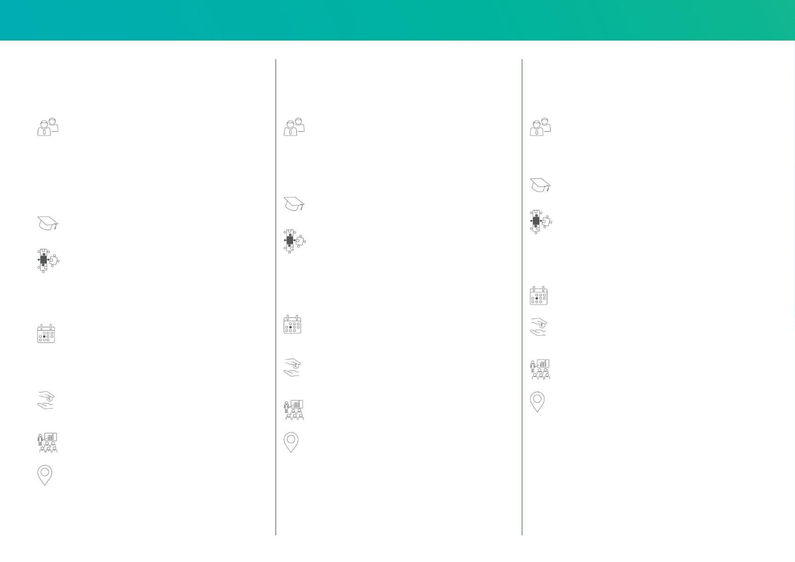
| Automation and remote control technology
Automation/
Automation/
Device and
ACOS 7 series remote terminal units
– Basic knowledge –
ACOS 7 series remote terminal units
– Advanced –
Patch management
Target audience
Target audience
Target audience
This course is designed for beginners with no prior
knowledge of remote control and automation technology.
Participants who have already completed the basic knowledge
course or have comparable basic knowledge in remote control and
automation technology can deepen their skills in this seminar.
The course is aimed at system administrators who are responsible for
remote terminal units and their software maintenance.
A key issue is patch and device management via a centralized update server.
It is ideal for new employees, career changers, or anyone working with
VIVAVIS remote control systems for the first time. Participants
will receive a clear introduction to the technical fundamentals and
operation of remote control technology.
It is suitable for users who want to use more complex functions of
the systems safely.
Requirement
Requirement
ACOS 7 series remote terminal units
– Basic knowledge –
Requirement
no prior knowledge required
ACOS 7 series remote terminal units
– Basic knowledge –
Module
Module
• Central user management
• Inventory of ACOS 7 devices
• Patch management
Module
• Device diagnostics with the IEC tester and RSU
• Parameterization of different message types
• Communication and certificate management
• PLC programming with CODESYS®V3
• Tasks and application areas of remote control technology
• Initial device parameterization with ACOS ET
• Collection and processing of process information
- Firmware version management
- Scheduling of firmware updates
• Device diagnostics using the website
• PLC functions
• Introduction to projects and communication according to
NIS2
Appointments
On request
Appointments
Appointments
fee
On request
On request
On request
(1 seminar day)
fee
Speaker
€On request
(2 seminar days)
Kai-Uwe Pieper
fee
Speaker
Venue
On request
(3 seminar days)
Kai-Uwe Pieper
Ettlingen
Speaker
Venue
Kai-Uwe Pieper
Ettlingen
Venues
Ettlingen, Bochum and Berlin

Slide 4
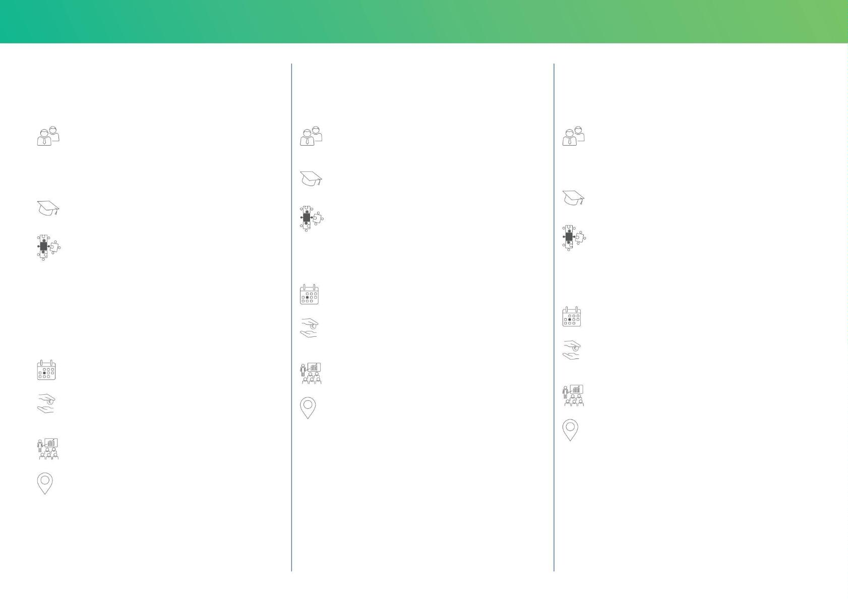
Simplified Engineering
IEC 61850
PLC programming with
CODESYS® V3
Target group :
Target group :
Users and system administrators who want to learn about
communication structures and the mapping of hardware, system
and logical objects of the ACOS 7 series remote terminal
units to IEC 61850 data attributes.
Participants who wish to learn about the functionality and scope of
the integrated PLC CODESYS® V3.
Requirement
ACOS 7 series remote terminal units
– Basic knowledge –
Requirement
Modules •
ACOS 7 series remote terminal units
– Basic knowledge –
Parameterization of the remote terminal units of the ACOS 7 series for PLCs with ACOS ET
Module •
• Creation of PLC programs according to IEC 61131-3 • Data
Introduction to IEC 61850 • ACOS
exchange between the PLC, control system and remote
terminal units
750 as a server/client for integration into IEC 61850 networks
• Working with ICD or CID files
appointment
• Working with the SCD project file • Mapping
of information objects • Editing data records,
creating additional data records • Goose communication
On request
fee
• Activate reporting
On request
(3 seminar days)
appointment
Speaker
On request
Kai-Uwe Pieper
fee
Venue
On request
(2 seminar days)
Ettlingen
Speaker
Kai-Uwe Pieper
Venue
Ettlingen

Slide 5
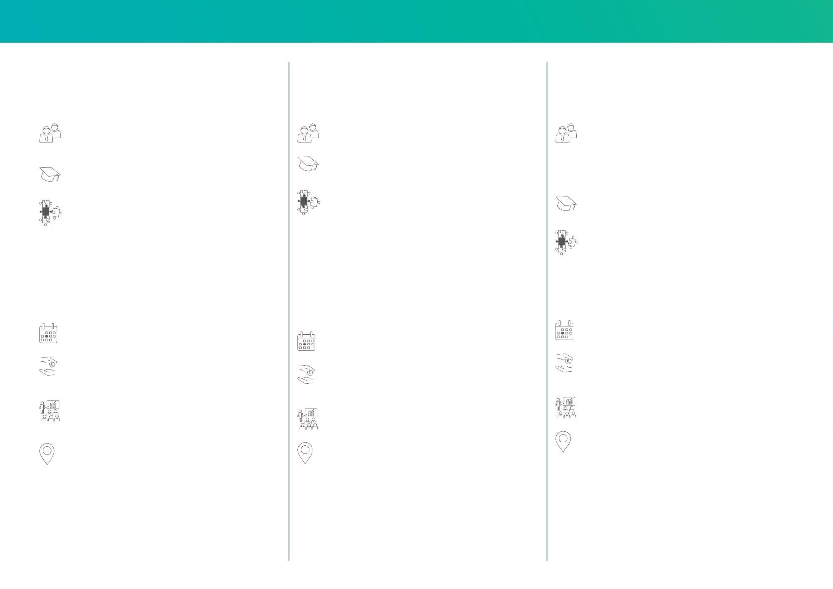
| Automation and remote control technology
ACOS 300 protection devices
Target audience
Users of the ACOS 300 series of protective devices
No prior knowledge
required .
Modules •
Hardware setup and assembly •
Parameterization via the local display and the integrated web
server
• Parameterization and configuration via the
Engineering tool •
Parameterization and configuration of the
Communication interfaces
• Configuration of control logic via
IEC 61131-3 (Functional Diagram)
• Display Configuration • Practical Exercises
appointment
On request
fee
On request
(2 seminar days)
Speaker
Klaus Fletschinger, Dipl.-Ing. (FH)
Venue
Ettlingen

Slide 6
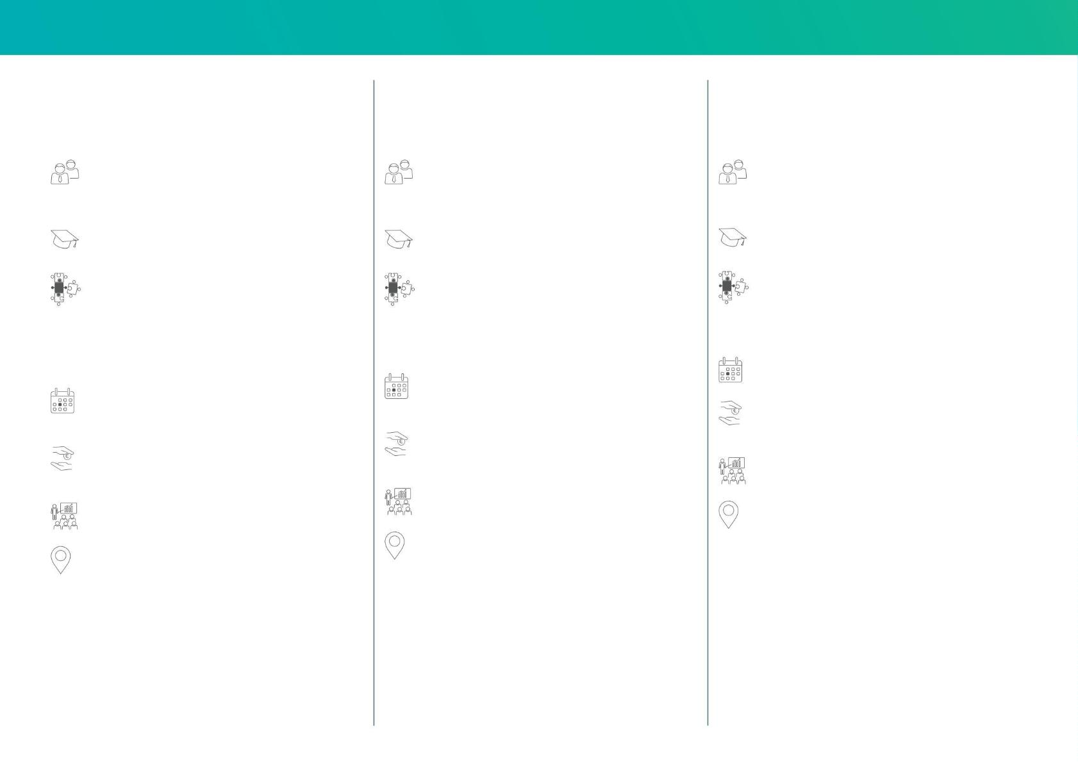
| Control technology
Parameterization HIGH-LEITE NT
Image generation HIGH-LEIT NT
HIGH-LEATHER NT topology
– electrical networks
Target group :
Target group :
Target group :
Administrators/system administrators who want to perform the
initial or subsequent parameterization in HIGH-LEIT NT.
Administrators/system administrators who want to create image
concepts, structures and elements in HIGH-LEIT NT.
Administrators/system administrators who want to use topological
network coloring for the power network control center in HIGH-LEIT NT.
No prior knowledge
Requirement
Parameterization HIGH-LEITE NT
Requirement
Parameterization HIGH-LEITE NT
required .
Module •
Modules •
Module
Fundamentals of operation and parameterization of
HIGH-LEATHER NT
Introduction to the structure of fixed, sample and
Geo-based network images •
• Generation of fully graphical system diagrams for electricity
distribution • Parameterization of earth
• Structuring the data model • Development and
Structuring of image layers • Working with
fault and short circuit detection • Standardized switching sequences,
color schemes, tracing
application of the HIGH-LEIT generation list • Archiving, archive graphics
and logging • Concept and structure of the alerting system
process visualization elements • Display of operating functions
Appointments
Appointments
On request
Appointments
On request
Fee
On request
On request
(3 seminar days)
Fee
Fee
On request
(4 seminar days)
On request
(4 seminar days)
Speaker Ulf
Speaker Ulf
Kudlocz, Dipl.-Ing. (FH)
Speaker Ulf
Kudlocz, Dipl.-Ing. (FH)
Venue
Kudlocz, Dipl.-Ing. (FH)
Venue
Ettlingen
Venue
Ettlingen
Ettlingen

Slide 7

Network operating functions
HIGH-LEIT NT in practice
Target group :
Administrators/system administrators who want to use the
network analysis functions in their control system in HIGH-LEIT
NT.
Requirement
Parameterization HIGH-LEITE NT
Modules •
Equipment and network data modeling for network
calculation functions • Strategies and
variants of network visualization • Determining the fault location
in the case of earth faults or short circuits • Fundamentals of network
calculation with HIGH-LEIT NT • Load flow calculation in practice,
with application examples for the most important parameters and
control variables
• Load matching in distribution networks for substitute value calculation
of unmetered local network substations •
Modeling of renewable energy grid feed-ins • Application
examples for short-circuit current calculation
appointment
On request
fee
On request
(2 seminar days)
Speaker Ulf
Kudlocz, Dipl.-Ing. (FH)
Venue
Ettlingen

Slide 8
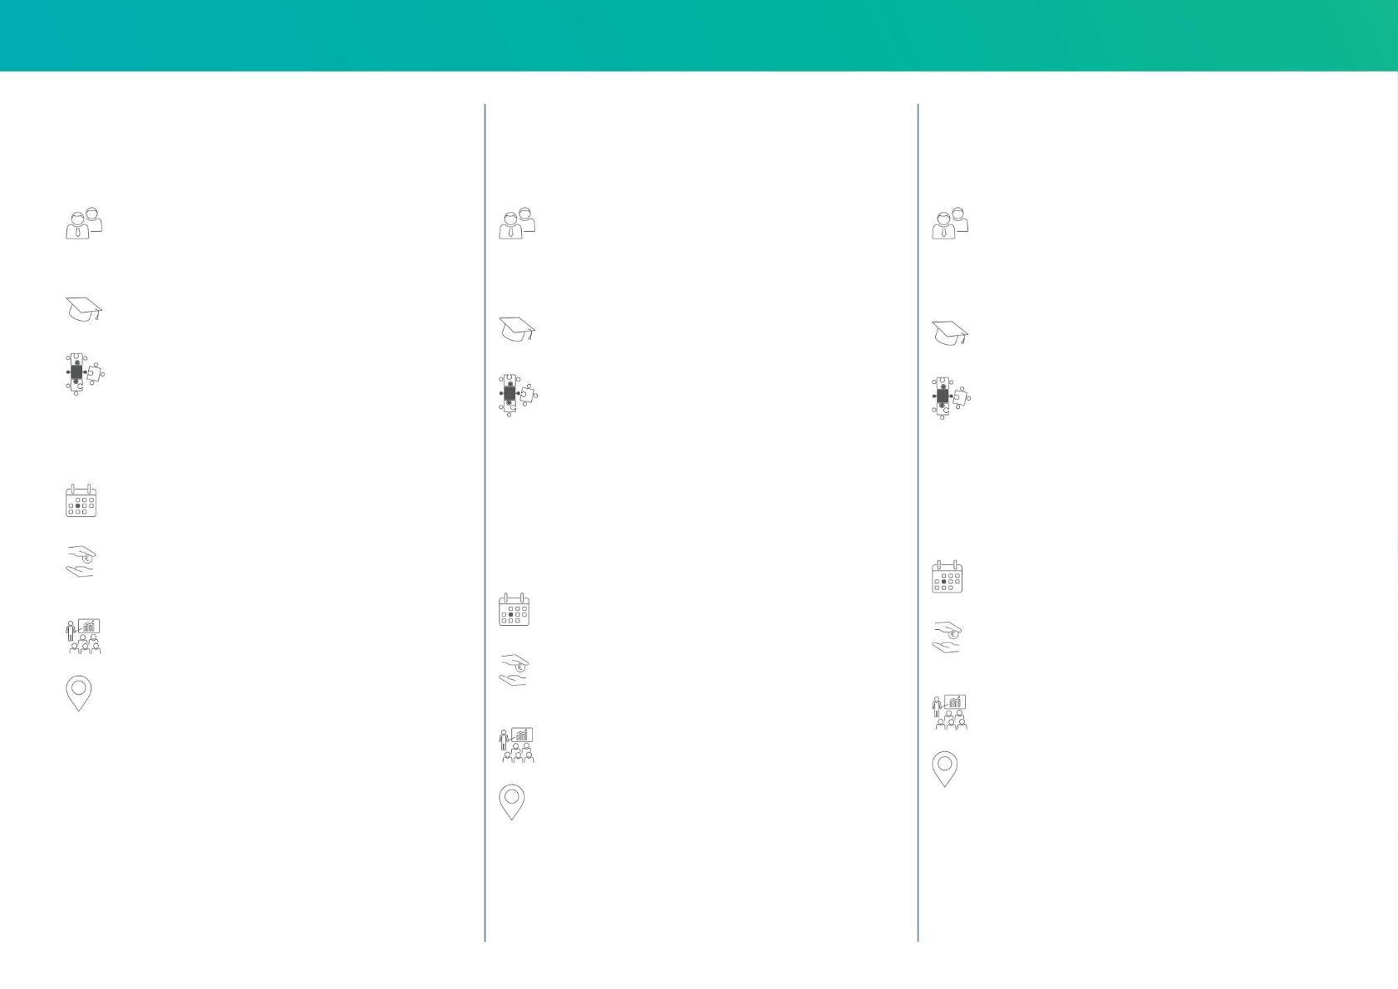
| Control technology
Parameterization with
HIGH-LEIT Engineering Suite
Object engineering and typing with
HIGH-LEIT Engineering Suite
Network calculation with
HIGH-LEIT Engineering Suite
Target group :
Target group :
Target group :
Administrators/system administrators of HIGH-LEIT who want
to parameterize the basic functions independently of the engineering
tool.
Administrators/system administrators of HIGH-LEIT Engineering
Administrators/system administrators of HIGH-LEIT NT who
want to use the topological network coloring and network calculation for the
power network control center in the HIGH-LEIT Engineering Suite.
Suite who want to use the new engineering tool to parameterize
and create their own types and templates.
Requirement
Basic knowledge of control technology
Requirement
Basic knowledge of control technology
Requirement
Seminar S 341
Module •
Basics of operating and parameterizing HIGH-LEIT
Modules •
Module •
• Archiving, archive graphics and logging • Alarm and event list •
Concept and structure of the
Fundamentals of operating and parameterizing HIGH-LEIT
Engineering Suite • Generation of full-
Fundamentals of operating and parameterizing the topology and
network calculation in HIGH-LEIT
alarm system
graphical plant diagrams for the electricity/gas/water/district heating
sectors
Engineering Suite •
• Creating and using templates in
Object engineering •
Generation of plant diagrams for electricity
distribution
Appointments
Creating types, presets and
Visualization types •
• Parameterization of earth fault and short circuit detection •
Standardized switching sequences, color-coding variants, tracing •
Fundamentals and updates of load flow calculation
On request
Fee
Activating engineering data in the runtime system • Working with
process visualization elements
On request
(2 seminar days)
appointment
Appointments
on request
Speaker Ulf
On request
Fee
Kudlocz, Dipl.-Ing. (FH)
fee
On request
(2 seminar days)
Venue
On request
(4 seminar days)
Ettlingen
Speaker Ulf
Speaker Ulf
Kudlocz, Dipl.-Ing. (FH)
Kudlocz, Dipl.-Ing. (FH)
Venue
Venue
Ettlingen
Ettlingen

Slide 9
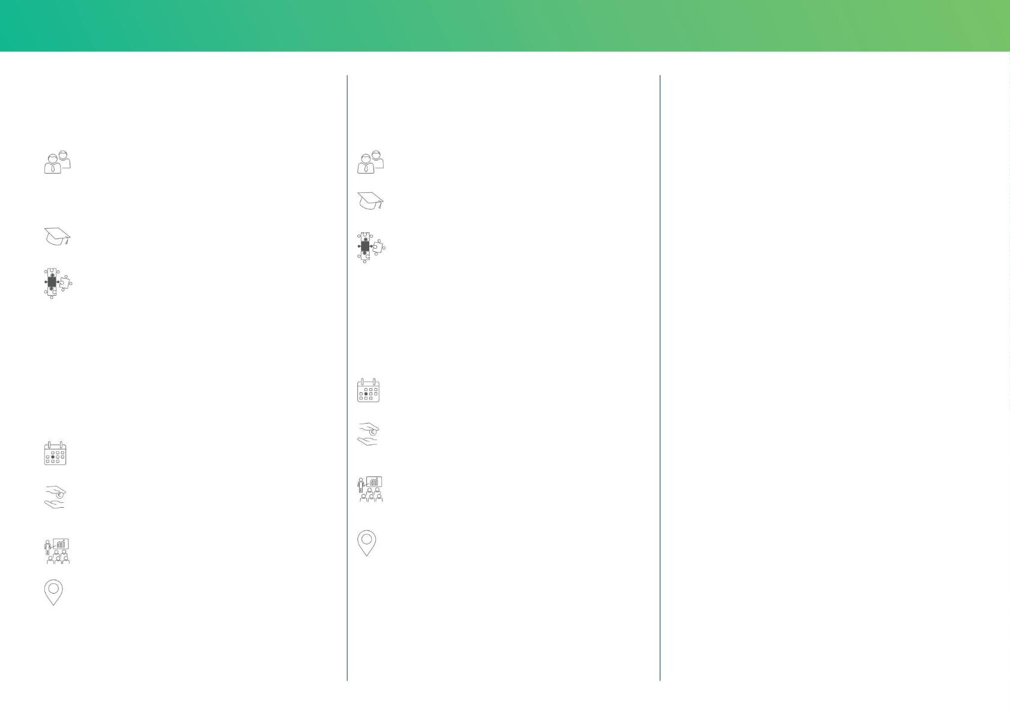
Machine Translated by Google
Control technology | 13
Parameterization and
ISMS supplier audit for
Customers and partners
Image generation HIGH-LEIT XW
Target audience
Target audience
Administrators/system administrators who want to perform
initial or subsequent parameterization in HIGH-LEIT XW and
create image concepts, structures and elements.
Information Security Officer
Requirement
no prior knowledge required
Requirement
Modules •
no prior knowledge required
Central guidelines and specifications of the ISMS
according to
Module •
ISO27001 • Handling of information security incidents,
Business Continuity
Generation and structuring of the
Basic data model
• Creating plant images with ProBild • Developing
• Building tour through server rooms and
relevant jobs
image concepts and text hierarchies • Applying object-oriented generation
• Operational and communication security
and pattern image technique
• Security in development • Security in
customer projects
• Evaluation of archive data using event lists,
Graphics and logs
• Defining users and access rights • Concept and structure
of the alerting system • Generation of topological
network elements
appointment
September 22, 2026
fee
appointment
€1,400 Seminar no. S332
(1 seminar day)
March 23 – March 27, 2026
fee
Speaker
€5,055 Seminar no. S308
(5 seminar days)
Harald Herrmann
Peter Schwark, Dipl.-Inform. (FH)/Ing. (FH)
Speaker
Venue
Ulf Kudlocz, Dipl.-Ing. (FH)
Ettlingen
Venue
Ettlingen

Slide 10
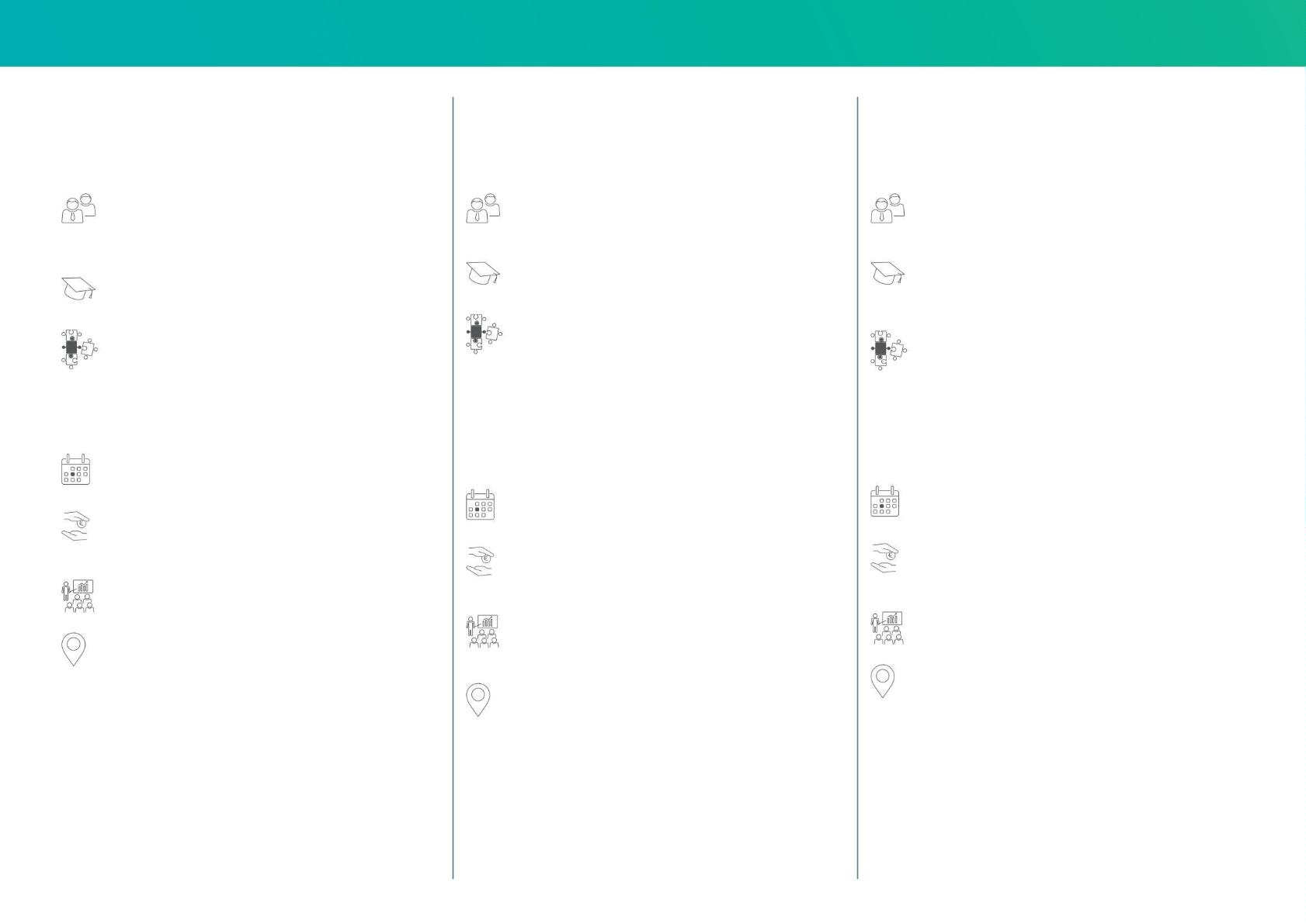
Machine Translated by Google
14 | Control technology
Workshop for HIGH-LEIT NT
Operation of HIGH-LEIT NT in a
Active Directory domain
IT security workshop in the
Control technology for the network sector
System administrators
Target group :
Target audience
Target audience
Administrators/system administrators of HIGH-LEIT NT who
would like to gain administrative insights into the server and MMI.
Administrators/System Administrators of HIGH-LEIT NT
Administrators/System Administrators of HIGH-LEIT NT
Requirement
No prior knowledge
Requirement
Seminar S 307
required .
Basic knowledge of control technology as well as in the
IT security
Modules •
Modules •
Modules •
Fundamentals of the HIGH-LEIT NT system concept •
Components of the HIGH-LEIT NT software • Operation
and monitoring of the control system • Diagnostics in case
of faults (server and MMI) • Data and system recovery
Fundamentals of virtualization using Hyper-V as an example • Fundamentals
Secure network and system design • System
of Active Directory • Use cases for domain
controllers
hardening using a
in high-leit networks
Windows Active Directory • Patch
• Interaction with HIGH-LEIT NT • Function and
configuration of Group Policy Objects (GPOs) • System hardening • Domain
administration
management • Availability
through system monitoring • Functionality of anomaly
detection within a control center
appointment
May 19, 2026
appointment
appointment
June 9, 2026
fee
May 20-21, 2026
€1,400 Seminar no. S 300 (1 seminar
day)
Fee
Fee
Speaker Ulf
€2,775.00 Seminar No. S 312 (2
seminar days)
€1,400.00 Seminar No. S 310 (1
seminar day)
Kudlocz, Dipl.-Ing. (FH)
Speaker Olaf
Speaker
Venue
Janke, Dipl.-Ing.
Tobias Jahnke
Ettlingen
Systema Datentechnik GmbH
Venue
Venue
Ettlingen
Ettlingen

Slide 11

Machine Translated by Google
METERING AND
LOW VOLTAGE
NETWORK GUIDANCE

Slide 12
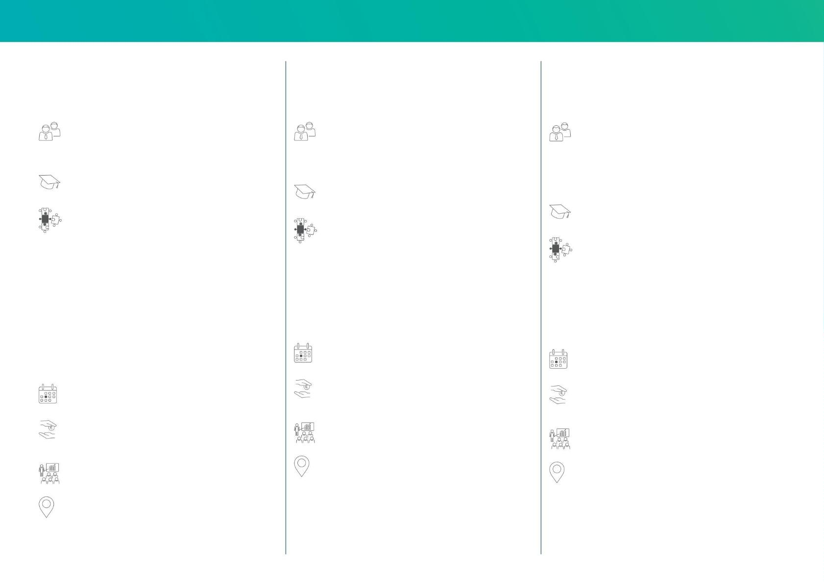
Machine Translated by Google
16 | Metering
IDSpecto.ADMIN
Skalar.pro
CLS operator
Target group :
Target group :
Target group :
Users from the areas of meter management, network administration, and
energy data acquisition and distribution who work with
IDSpecto.ADMIN.
Users of the metering department who are responsible for the
Users of the metering department or network expansion
planning, preparation and equipping of metering points and the associated
technical possibilities.
who are entrusted with the planning, preparation and equipping
of metering points and the associated technical possibilities.
No prior knowledge
The focus is on practical content related to the application of
the IDSpecto.CLS operator.
required .
Prerequisite: General
Modules •
knowledge of how to use IDSpecto.Admin
No prior knowledge
Overview: IDSpecto.ADMIN and its modules • System handling
with desktop and menu navigation • Object structures and data content
• Users and user groups • Dynamic relationship
groups • Event and time control •
Modules •
required .
Overview of the Skalar product family • Basic functions
Modules •
of Skalar.pro • Connection and commissioning
• Configuration via the browser
Introduction to the Technical Guideline • Fundamentals
of PKI and Certificates • Market Processes and
Responsibilities • System Structure and
Architecture • Operation of the CLS
Operator • Switching (Schedules, Ad-
hoc, EEBUS) • Update and Configuration •
Monitoring
Measurement field management and
- Configuration options for administrators and technicians
configuration • Data acquisition jobs •
Remote reading job management • Creating and
assigning devices (meters,
• Insight into value-added applications
NOTE: You are welcome to bring your own Skalar.pro.
Modems and converters) •
Creating raw data filters for customer-specific needs
Requirements •
Appointments
Appointments
Monitoring and transmission analysis
February 24, 2026
September 15, 2026
May 19, 2026
October 27, 2026
Appointments
Fee
Fee
March 17th – March 19th, 2026
November 10th – November 12th, 2026
€1,400.00 Seminar No. M 520 (1
seminar day)
€2,545.00 Seminar No. M 530 (1.5
seminar days)
fee
Speaker
Speaker
€3,060 Seminar no. M 500 (3 seminar
days)
Alexey Burmisov
Alexey Burmisov I Benjamin Drude
Speaker
Venue
Koblenz
Venue
Koblenz
Marko Reinert and Sven Hennrichts
Venue
Koblenz

Slide 13

Machine Translated by Google
Low-voltage network management | 17
Practical workshop: Working successfully
with SGOP in network operations
Target audience
Users of the SGOP
No prior knowledge
required .
Module •
Fundamentals and operation of Smart Grid operation
Platform (SGOP) •
Real-time monitoring and fault analysis • Data
integration and visualization • Automation and
process optimization
Dates:
September 8–9, 2026 (in Ettlingen) and
September 15–16, 2026 (in Baden-Dättwil)
fee
€2,775 Seminar no. M 525 (2
seminar days)
Speaker
various SGOP experts
Venue
Ettlingen/Baden-Dättwil

Slide 14

Machine Translated by Google
MORE
SEMINAR TOPICS

Slide 15
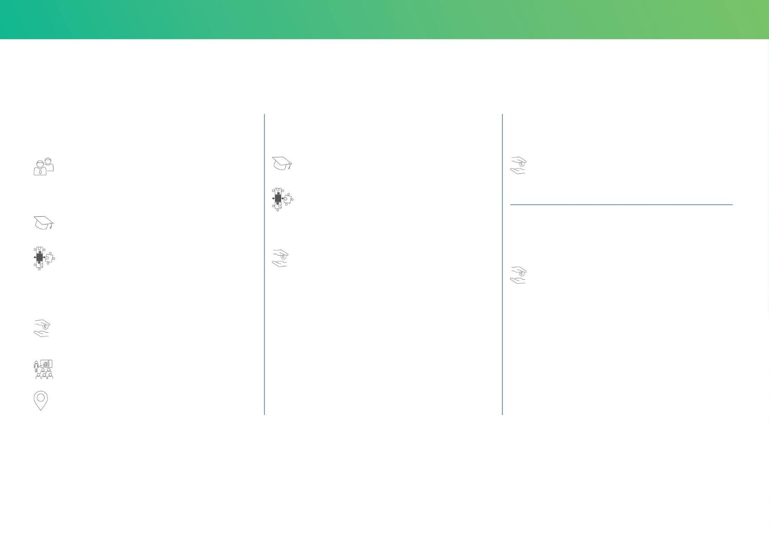
Machine Translated by Google
Further seminar topics | 19
Dear seminar participants,
Here you will find further seminar topics that we would be happy to offer you upon request. We would also be pleased to provide you with offers for project-specific
seminars tailored to your specific topic requirements, which can be conducted at your location or in Ettlingen specifically for you.
NIS2
NEW!
Feed-in management HIGH-LEIT
IDSpecto.scadalink
Target group:
No prior knowledge
fee
In our online seminar, we show in a compact and practical way
why you already meet 80–90% of the NIS2 requirements with
ISO 27001 – and which building blocks need to be specifically added.
required .
€2,775 Seminar no. SP 421 (2
seminar days)
Module
• Administration
No prior knowledge
• Control system configuration •
required .
Implementation of measures • Load
shedding
IDSpecto.ADMIN for professionals
Modules •
fee
Documentation of management responsibility • Clear reporting
processes with deadlines • Binding
€1,400 Seminar no. SP 404 (1
seminar day)
Fee
implementation of MFA • Reliable evidence
in the supply chain
€2,775.00 Seminar No. SP 502 (2
seminar days)
• Audit-proof documentation
Fee €
560,– Seminar No. SP 420 (0.5
seminar days)
Speaker
Harald Herrmann
Venue
On-line

Slide 16
Machine Translated by Google
GENERAL
INFORMATION

Slide 17

Machine Translated by Google
Hotel suggestions for seminar participants | 21
To make your hotel search easier, we have compiled this list for you. We have negotiated special rates with these hotels for 2026, which you can only take advantage of if you book through us. Payment will be made directly by
the hotel. Please return this completed form to us with your seminar registration.
Ettlingen
Koblenz
Berlin
Hotel Erbprinz,
*****
Top Hotel Krämer ***
Cardinal Krementz Street 12, 56073 Koblenz,
www.tophotel-k.de
***
Rheinstraße 1, 76275 Ettlingen
www.erbprinz.de
Premier Inn Berlin Airport Alexander-
Meißner-Straße 2, 12526 Berlin Our double rooms
are equipped with a super comfortable bed, private bathroom
with shower and free Wi-Fi, offering everything you need for a
restful sleep.
Overnight stay excluding breakfast: €118.00
Breakfast per person: €17.50
Overnight stay including
from €93.50
breakfast: (Comfort single room)
Traditional family hotel in the old town of Ettlingen.
Wellness area with swimming pool.
WiFi access, a bottle of mineral water and use of the Tassimo
capsule machine in the room are included in the room price.
The hotel is located near Berlin Brandenburg Airport in
Schönefeld.
Distance to VIVAVIS approx. 3 km.
Modern hotel in a central, easily accessible location.
Distance to VIVAVIS approx. 6 km.
Note: Bookings can be made directly
Hotel Watthalden ***
via https://www.premierinn.com/de/de/home.html
Pforzheimer Straße 67 A, 76275 Ettlingen,
www.villa-watthalden.de
Overnight stay including
€106.00
Bochum
breakfast: Modern hotel on the outskirts of Ettlingen in a quiet location.
art Hotel Tucholsky
Viktoriastraße 73, 44787 Bochum,
info@art-hotel-tucholsky.de
Distance to VIVAVIS approx. 4 km.
Ibis Styles Ettlingen,
**
Karlsruher Straße 13-15, 76275 Ettlingen
www.ibis.com
Overnight stay excluding
breakfast: Breakfast per
from €95.00
€19.90
Overnight stay including
€100.00
person: Stylish hotel in the city center with tapas bar and
breakfast: The hotel is located at the entrance to Ettlingen.
Distance to VIVAVIS approx. 2.5 km.
restaurant. Free Wi-Fi, paid parking nearby.
The hotel does not send invoices! Payment is due upon arrival!
Only 400 m to the main train station.
Distance to VIVAVIS: Travel time approx. 13 min.
Hey Lou Karlsruhe Trade Fair Nell-
Breuning-Ring 23, 76287 Rheinstetten
www.heylouhotels.com
Overnight stay including
€96.00
Please make a reservation.
Single room of
until
in the hotel marked above.
breakfast: (outside of trade fair periods)
The hotel is located near the Karlsruhe Trade Fair Center.
Travel time to VIVAVIS approx. 12 min.
Name | Company | Email
Date | Signature
Bookable directly via booking code: LCI0711VIV

Slide 18
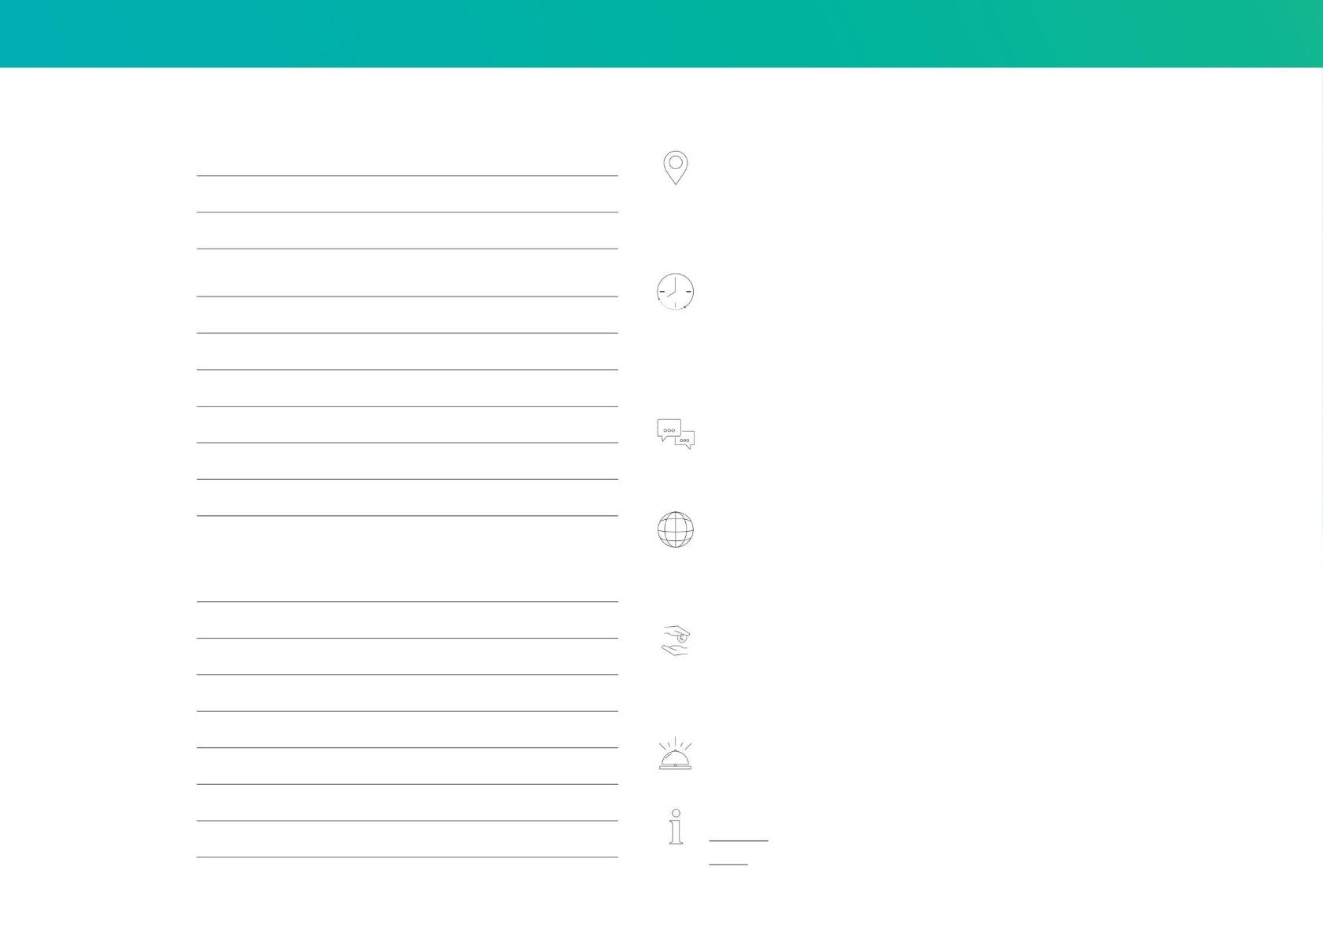
Machine Translated by Google
22 | Registration
academy@vivavis.com
Registration
for the seminar
Venue: Training rooms of
VIVAVIS AG: Nobelstraße 18, 76275
at
Ettlingen; August-Thyssen-Straße 32,
56070 Koblenz; Josef-Baumann-Straße 37, 44805
Bochum. Parking available.
fee
Participant
Seminar schedule for
one-week events: Starts Monday at
First and Last Name
position
2:00 PM, ends Friday at 12:00 PM. Daily seminar duration: 9:00
AM – 5:00 PM.
One-day/multi-day events: Start 9:00 a.m., end 5:00 p.m. If seminars take place at
different times, these times will be communicated to you with the registration confirmation.
First and Last Name
position
Contact For
questions regarding our training courses, please contact Bettina Baumann: Phone +49 7243/2 18 - 700 Email
bettina.baumann@vivavis.com
First and Last Name
position
Book online via email:
Please make a reservation according to the enclosed completed hotel list.
academy@vivavis.com or www.vivavis.com. Places are limited and will
be allocated on a first-come, first-served basis. We reserve the right to cancel seminars in a timely manner if there
are insufficient participants.
Sender
Name/First name/Title
Fees: The
seminar fees include seminar materials, lunch, coffee breaks, and conference beverages and are per
person. They are subject to the applicable statutory value-added tax. You will receive an invoice after order
confirmation. Please pay it within 14 days of receipt. In case of short-notice cancellation (no later than three weeks before
the start of the seminar), the fee will only be refunded if the place can be filled.
Department/Function
company
Street
We will
ZIP / City
gladly arrange hotel rooms for you. Please fill out the enclosed hotel list. You will settle the accommodation costs directly
with the hotel.
Telephone/Fax
e-mail
Note:
CODESYS® is a registered trademark of CODESYS GmbH.
IRMA® is a registered trademark of VIDEC Data Engineering GmbH.
Please provide us with a different billing address if applicable.

Slide 19
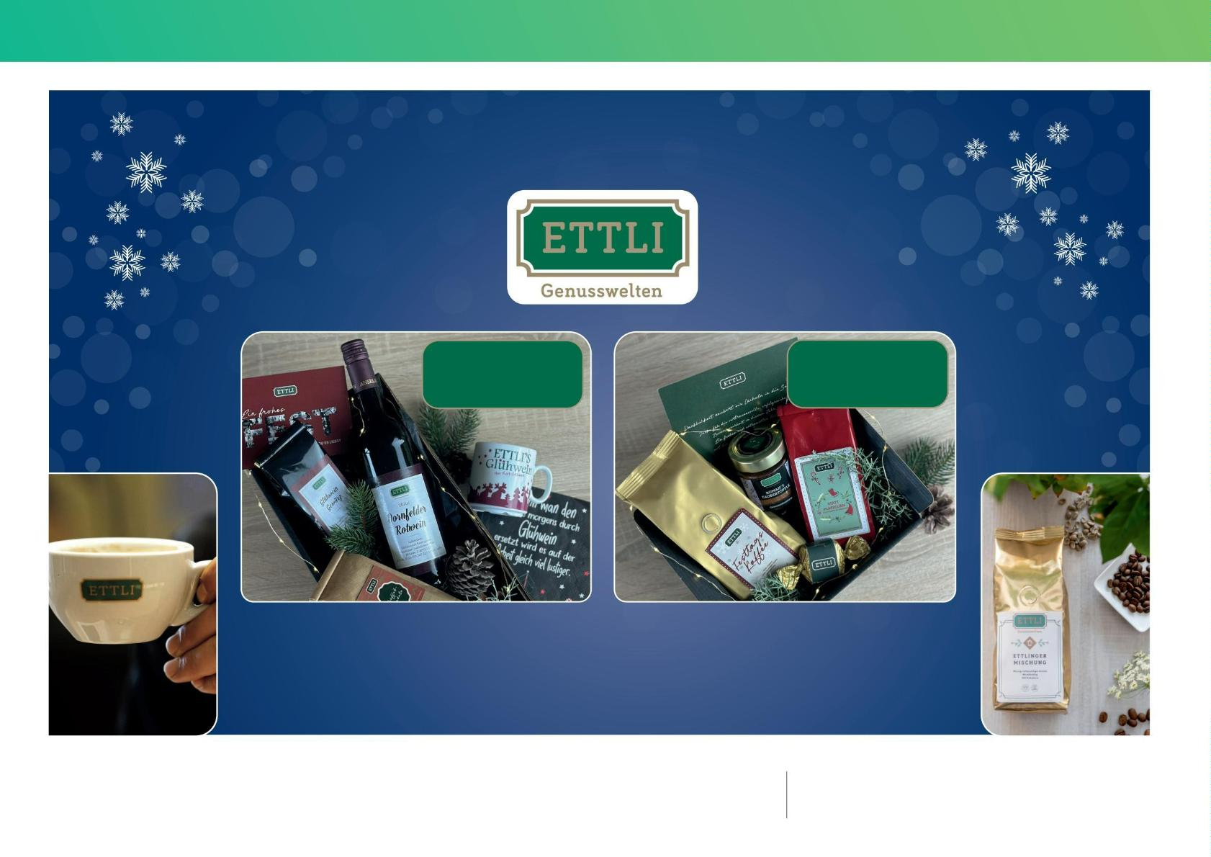
Machine Translated by Google
Competition | 23
We are giving away prizes in cooperation with
2x ETTLI's
2x ETTLI's
Cult mulled wine
Small variety
Wishing all participants good luck and enjoyable
moments with these specialties.
Terms and conditions of participation:
Participation coupons, along with the other seminar materials, will be made
available online by the speakers. All employees of VIVAVIS AG and its sister and
affiliated companies are excluded from participation.
The participant acknowledges that no legal claims can be made against VIVAVIS AG and ETTLI Kaffee GmbH arising from participation in the prize draw . Cash payment of
the prize value is not possible. The drawing from all fully completed coupons will take place in December 2026. This will be conducted anonymously and confidentially by a
VIVAVIS employee. The winners will be notified immediately and directly after the drawing.

Slide 20

Machine Translated by Google
VIVAVIS AG
Nobelstrasse 18
76275 Ettlingen
Germany
T +49 7243 218 0
E info@vivavis.com
www.vivavis.com

